Slide 1

MENTAL HEALTH AWARNESS
02/11/2022

Slide 2
Introduction
Health is state of complete physical , mental and social wellbeing, and not merely the absence of disease or infermity ( WHO)
No health without mental health.
Mental health refers on how we think , feel , and behave.

Slide 3
Introduction
Approximatly one in five children display signs of poor mental health, at any given time (WHO)
About of half of all mental illness begin in childhood and adolescence (WHO)

Slide 4
Introduction
AIMS:
To raise awarness about mental health conditions
To remove the stigma related to having a mental illness
To encourage student to seek help when they needed
To prevent

Slide 5

MYTH AND REALITY

Slide 6
Myth and reality ?
MYTH: Mental health disorders are rare
REALITY: One in five people will face a mental health problem in course of his life

Slide 7
Myth and reality ?
MYTH: People with a mental health problem never recover.
REALITY :With the appropriate resources, the majority of people struggling with mental health issues are recovering.

Slide 8
Myth and reality ?
MYTH : people with depression can get out of it if they really want to
Reality : People with depression have serious symptoms that are beyond their control.

Slide 9
Mental health and violence

Slide 10
Mental health and violence
The percentage of murders committed by people with mental illness has dropped in the past 50 years
You are more likely to be struck by lightning than killed by a mentally ill stranger (chances are 1 in 10 million)
People with mental illness are more often victims than perpetrators of violent crime.
People with mental illness are more likely to harm themselves than others

Slide 11
Mental illness

Slide 12
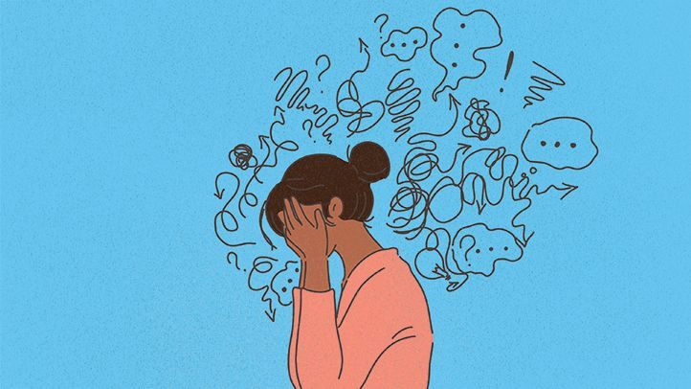
Depressive disorder

Slide 13
Depressive disorder
What is depression ?
All children feel low or down at times, it’s a natural part of growing up. But these emotions can be worrisome when felt intensely over long periods of time, particularly if they affect the child’s social, family and school life.
Depression is one of the most common types of mental health conditions.
Depression can be mild and short-lived or severe and long-lasting. Some people are affected by depression only once, while others may experience it multiple times.

Slide 14
Depressive disorder
Depression can lead to suicide, but this is preventable when appropriate support is provided. It’s important to know that much can be done to help young people who are thinking about suicide.
What causes depression?
Depression can happen as a reaction to something like abuse, violence in school, the death of someone close or family problems like domestic violence or family breakdown. Someone might get depressed after being stressed for a long time. It can also run in the family. Sometimes we may not know why it happens.

Slide 15
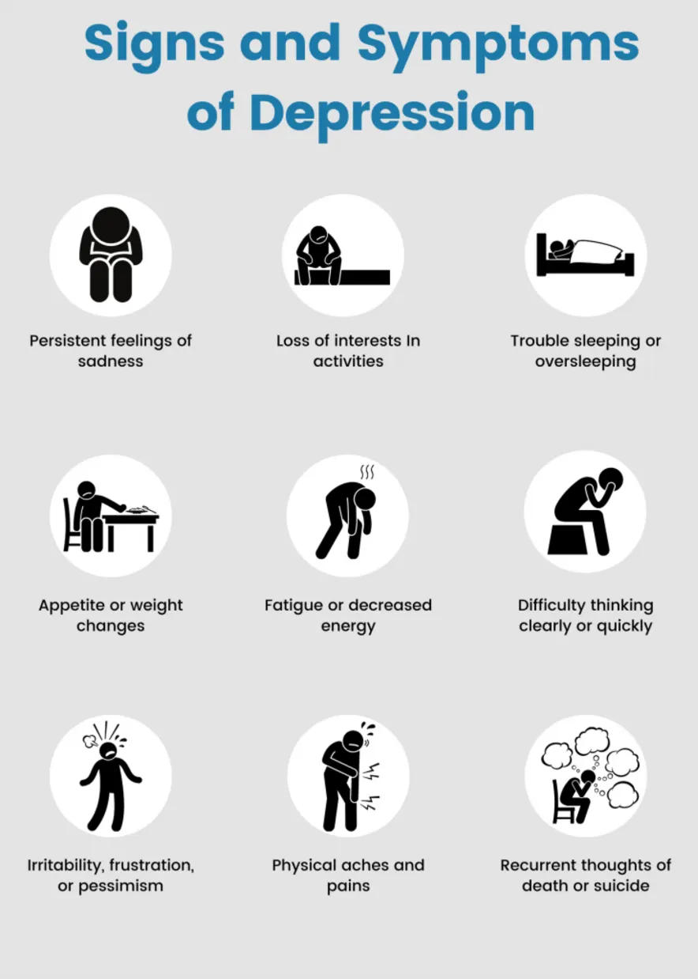

Slide 16
Normal anxiety vs pathological anxiety
Normal anxiety
Is related to a specific situation or problem
Lasts only as long as the situation or problem
Is proportional to the situation or problem
Is a realistic response to a realistic problem or situation

Slide 17
When someone experiences an anxiety disorder.
Anxiety may come up unexpectedly, for seemingly no reason
The anxiety response to a situation or problem may be much stronger that they would expect
They may experience a lot of unrealistic anxiety, such as fear of a situation that likely will never happen
Anxiety may last for a long time, even when the situation or problem has been resolved
Anxiety may feel impossible to control or manage
They may avoid situations or things that they believe to trigger anxiety symptoms

Slide 18
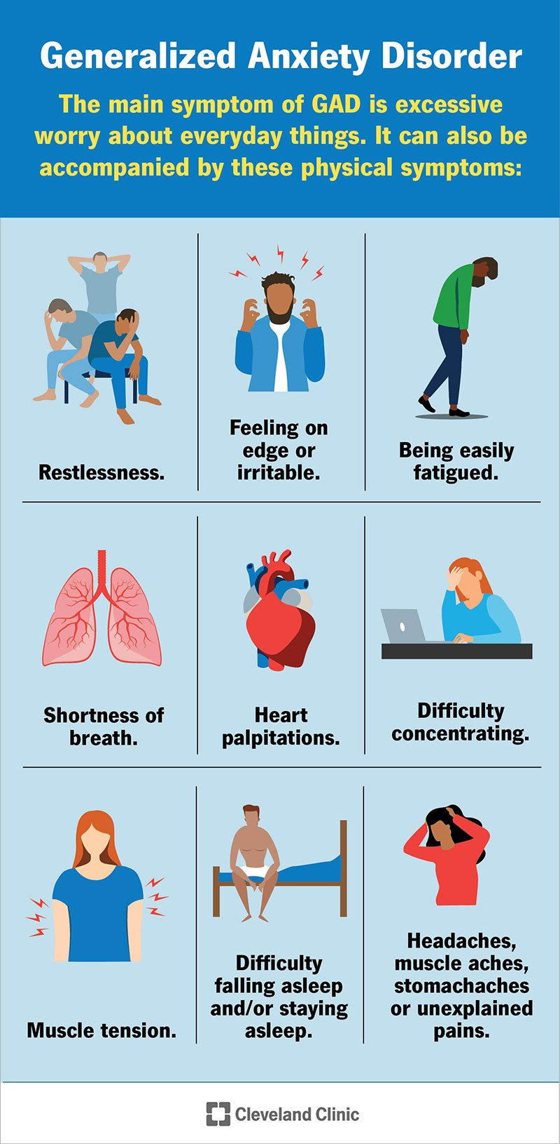

Slide 19
Panic disorder
Recurrent and unexpected panic attacks
Persistent concern about additional attacks or their consequences
A significant maladaptive change in behavior related to the attacks

Slide 20
Panic attack :
A discrete period of intense fear or discomfort developed abruptly and reached a peak within 10 minutes

Slide 21
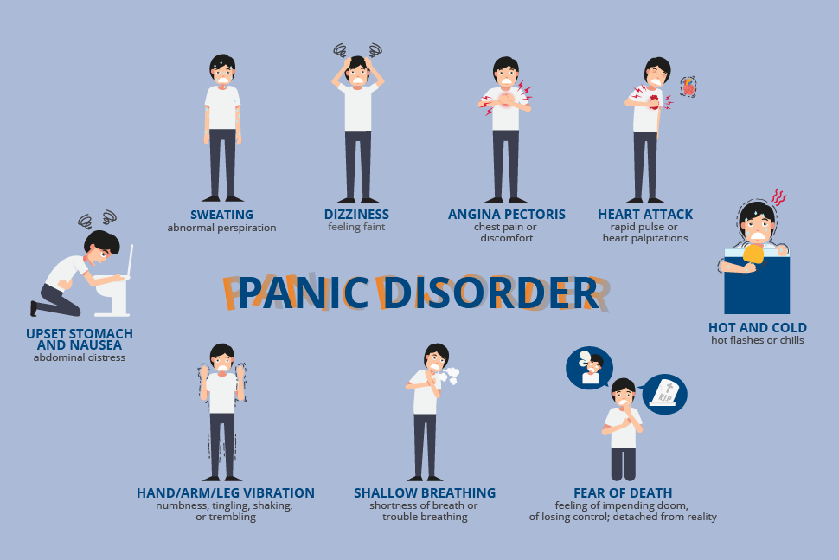

Slide 22
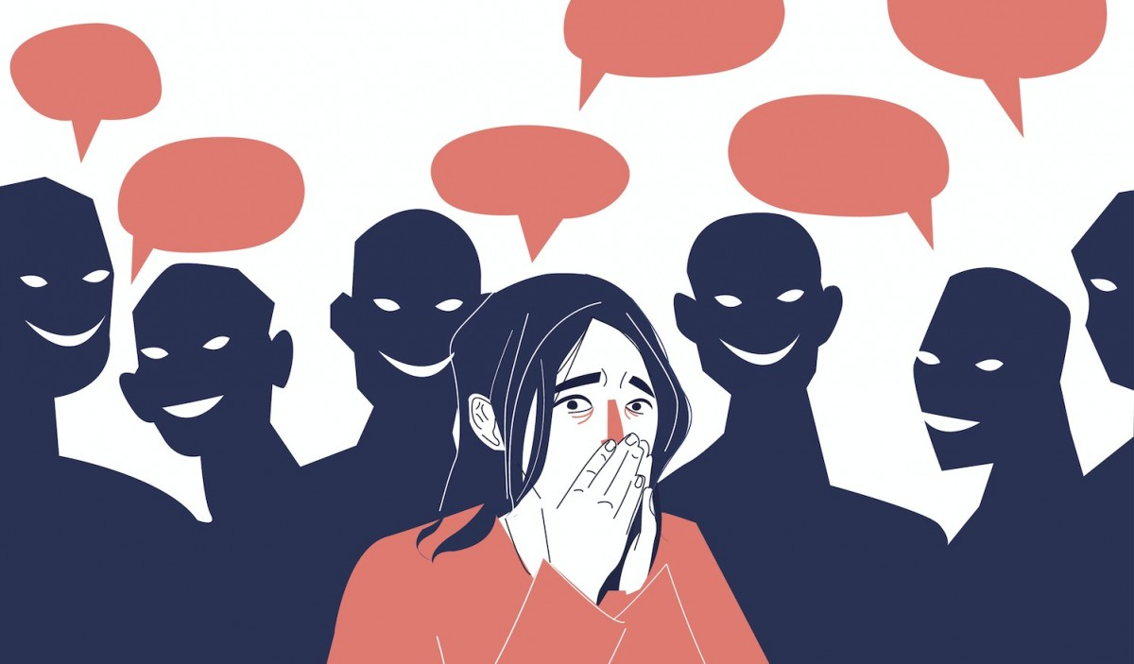
Social phobia

Slide 23
Social phobia
Persistent, intense fear or anxiety about specific social situations because he believe he may be judged negatively, embarrassed or humiliated
Avoidance of anxiety-producing social situations or enduring them with intense fear or anxiety

Slide 24
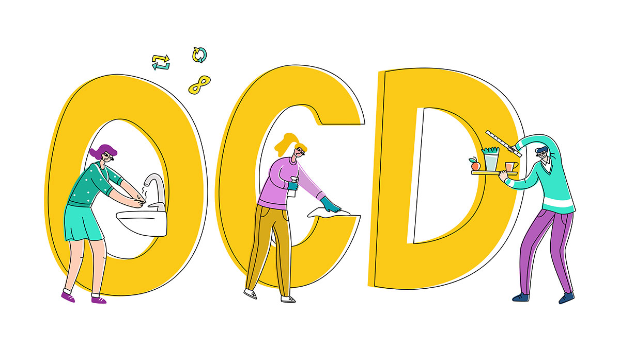
Obsessive compulsive disorder

Slide 25
Obsessive compulsive disorder
Recurrent and persistent thoughts, urges, or impulses that are experienced, as intrusive and unwanted, and cause marked anxiety or distress.
The individual attempts to ignore or suppress such thoughts, urges, or images, or to neutralize them with some other thought or action (i.e., by performing a compulsion).

Slide 26
The obsessions or compulsions are time-consuming (e.g., take more than 1 hour per day) or cause clinically significant distress or impairment in social, occupational, or other important areas of functioning.

Slide 27
Addiction
Addiction is an inability to stop using a substance or engaging in a behavior even though it is causing psychological and physical harm.

Slide 28
Addiction
Using more of a substance than intended or using it for longer than you’re meant to.
Trying to cut down or stop using the substance but being unable to.
Experiencing intense cravings or urges to use the substance
Spending more time getting and using drugs and recovering from substance use.
Neglecting responsibilities at home, work or school because of substance use.

Slide 29
Other mental disorders
Bipolar affective disorder
Schizophrenia …..

Slide 30

MENTAL HEALTH PROMOTION AND PREVENTION

Slide 31
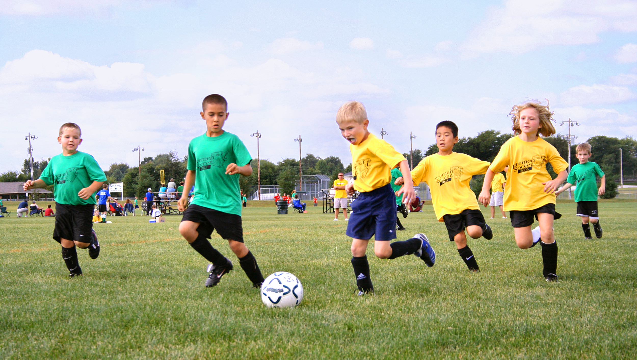
Regular Physical activity

Slide 32
Regular Physical activity
Reduce anxiety and stress
Increase self esteem
Improve the quality of sleep

Slide 33

Nutrition

Slide 34
Nutrition
Vitamin (B,C,D,E) and mineral deficiencies( calcium ,iodine , iron, magnisium) affect cognitition and the ability to learn and retain
Avoid stimulants
Eat healthy
Balanced calorie intake
Avoid alcohol, smoking

Slide 35

Sleep hygiene

Slide 36
Sleep hygiene
Regular hours
Sufficient hours
Avoiding certain activities in the bedroom (such as watching TV)
Avoid activities requiring a lot of concentration 2 hours before sleep
Promote relaxation activities before sleep( warm bath, book..)
Get Daylight Exposure
Cut Down on Caffeine in the Afternoon and Evening
Restrict In-Bed Activity: To build a link in your mind between sleep and being in bed, it’s best to only use your bed for sleep .
naps relatively short and limited to the early afternoon.
Dinner : not late , light

Slide 37

Relaxation

Slide 38
Relaxation
Breathing technic
Jacobson , shultz …
Warm bath
Meditation
Yoga
Music
Sport

Slide 39

Laugh /humor

Slide 40
Laugh /humor
Laugh releases and provides muscle relaxation
Take some distance from events, play them down
Buy tapes of comedians you love and listen to them when you need a boost
Read joke books or funny books
Watch your favorite comedy on TV
Don't take yourself too seriously

Slide 41

Time management

Slide 42
Time management
Objectives: Avoid being overwhelmed, disorganized , under permanent time pressure
Terms:
Establish priorities
A = urgent and important (must be done this week)
B = urgent (can wait until next week)
C = important (to be done soon)
D=not important not urgent ( cancel it )

Slide 43
Plan activities: Insert activities in time,
Sufficient and regular rest time (relaxation, sport, leisure, etc., music, reading, etc.)
Social support (friends, family)

Slide 44

Problem resolution

Slide 45
Problem resolution
Modalities:
Definition and Formulation of PB
Solution creation
Advantages/Disadvantages of each solution
Decision making (choice of solution)
Implementation and Evaluation of the chosen solution

Slide 46
Thank you

